Slide 1

Patient Adherence Prediction
Using Advanced Analytics to Predict Medication Adherence
September 2015

Slide 2
Problem and Impact
Poor Medication Adherence is a Problem of Striking Magnitude
32M use 3+ medications per day
75% non‐adherent in some way
Non‐adherence is related to:
1/3 of medication‐related to hospitalizations
125,000 deaths annually
Annual US impact estimated at ~$300B
Addressing non‐adherence could cover the
cost of healthcare for ~45M
157M people will have one or more chronic
conditions in 2020, most of which will be
treated with medications.
American College of Cardiology
New England Healthcare Institute. ‘Thinking outside the pillbox via Healthcare insights; Express Scripts Lab;

Slide 3
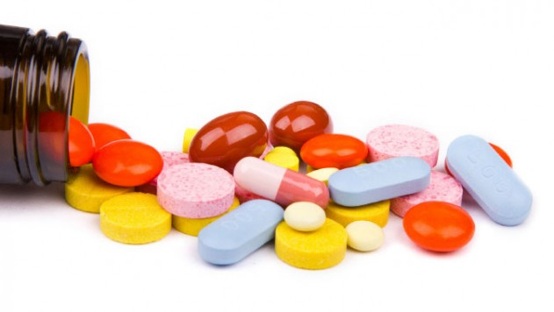

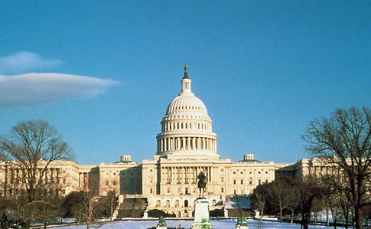
Primary Stake-Holders
Pharmaceuticals
Throttle overall sales.
Increased customer engagement
Limited risk of ill-effects
Flexibility to scale up
Providers
Improved overall quality of healthcare.
Mitigate risk of re-hospitalizations.
Decreased costs of healthcare.
Government
Decrease number of deaths.
Reduce overall amount spent.
Improved social responsibility.

Slide 4

Solving this big problem
Building a new Predictive Adherence system
Accurately assess and predict who is most at‐risk - Who is at risk for an adverse event in the near term? Identify what influencers of adherence differ for different people - What data‐driven factors are materially affecting adherence levels? Match people’s risk with tailored interventions - How can we adjust programs to target people based on different risk levels? Based on the above results, start with offers and Rewards.

Slide 5
The Solution
Analytics Solution Framework
Raw Data
Math model (Using R)
Patients list for Non-Adherence

Slide 6
How it works?
Meet Mary
PROFILE
Mary is 41 years old
Has chronic back pain
Has been prescribed daily medications for 6 months.
Patient– Medication Interaction
RECORD
ANALYZE
PRESCRIBE
COMMUNICATE
ENGAGE
Medications
Pharmacy
COMMITMENT
Mary buys the medicine from the pharmacy and
As part of her buy she provides basic data about prescription and herself to the pharmacy
System records the data and feeds it to the Patient adherence system to store and compare her medicine purchase data.
System detects her adherence based on her purchase history and other patients data.
When the system detects that Mary is non adhering it raises a trigger to engage her by promotions & offers based on her engagement.
Mary is back to adherence and overall healthcare experience is improved manyfolds.

Slide 7
Solution – Demo

Slide 8
Raw data Snapshot
PatientID | Medication | Age | Sex | Date | Pharmacy | Purchased By | RETAIL/MAIL | For_How_Many_Days | QTY | AmountPaid
1001 | Med1 | 57 | M | 2/9/2011 | PHARMACY 1523 | Patient Only | R | 30 | 30 | 14.35
1001 | Med1 | 57 | M | 3/31/2011 | PHARMACY 1523 | Patient Only | R | 30 | 30 | 14.35
1001 | Med1 | 57 | M | 5/22/2011 | PHARMACY 1523 | Patient Only | R | 30 | 30 | 14.35
1001 | Med1 | 57 | M | 7/5/2011 | PHARMACY 1523 | Patient Only | R | 30 | 30 | 14.35
1001 | Med1 | 57 | M | 8/11/2011 | PHARMACY 1523 | Patient Only | R | 30 | 30 | 14.35
1001 | Med1 | 57 | M | 9/18/2011 | PHARMACY 1523 | Patient Only | R | 30 | 30 | 14.35
1001 | Med1 | 57 | M | 10/22/2011 | PHARMACY 1523 | Patient Only | R | 30 | 30 | 14.35
1001 | Med1 | 57 | M | 11/21/2011 | PHARMACY 1523 | Patient Only | R | 30 | 30 | 14.35
1001 | Med1 | 57 | M | 1/22/2012 | PHARMACY 1523 | Patient Only | R | 30 | 30 | 14.35
1001 | Med1 | 57 | M | 2/20/2012 | PHARMACY 1523 | Patient Only | R | 30 | 30 | 14.35
1001 | Med1 | 57 | M | 4/21/2012 | PHARMACY 1523 | Patient Only | R | 30 | 30 | 14.35
1001 | Med1 | 57 | M | 5/18/2012 | PHARMACY 1523 | Patient Only | R | 30 | 30 | 14.35
1001 | Med1 | 57 | M | 7/19/2012 | PHARMACY 1523 | Patient Only | R | 30 | 30 | 14.35

Slide 9
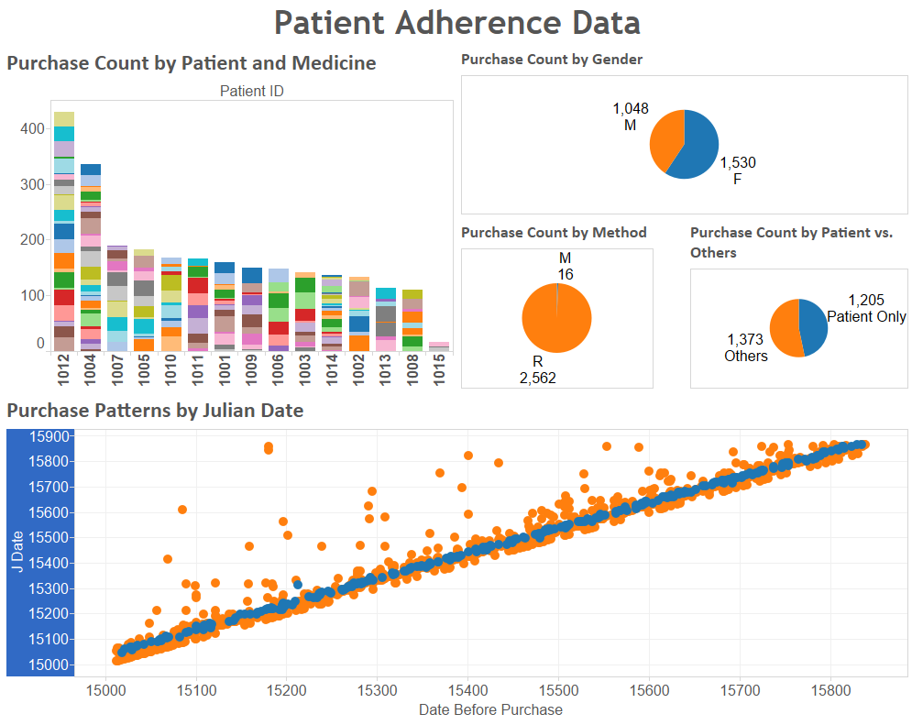
Visualizing the raw data
Features
Patient ID
Medication
Age
Gender
Date
Pharmacy
Purchased By
RETAIL/MAIL
For_How_Many_Days
Quantity

Slide 10
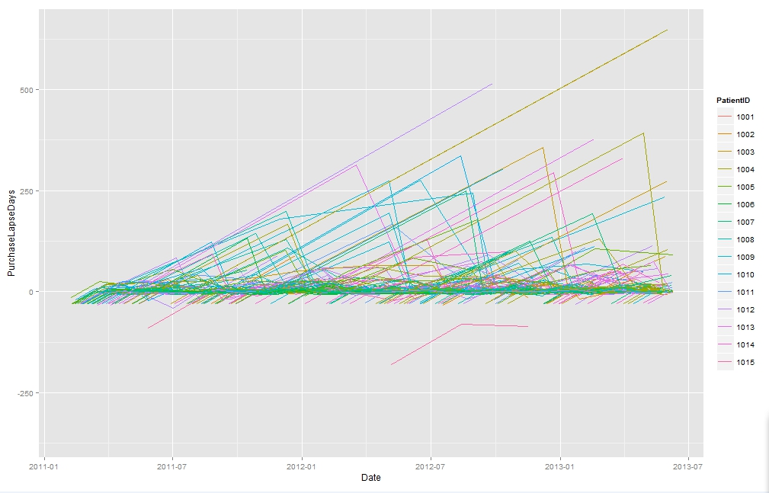
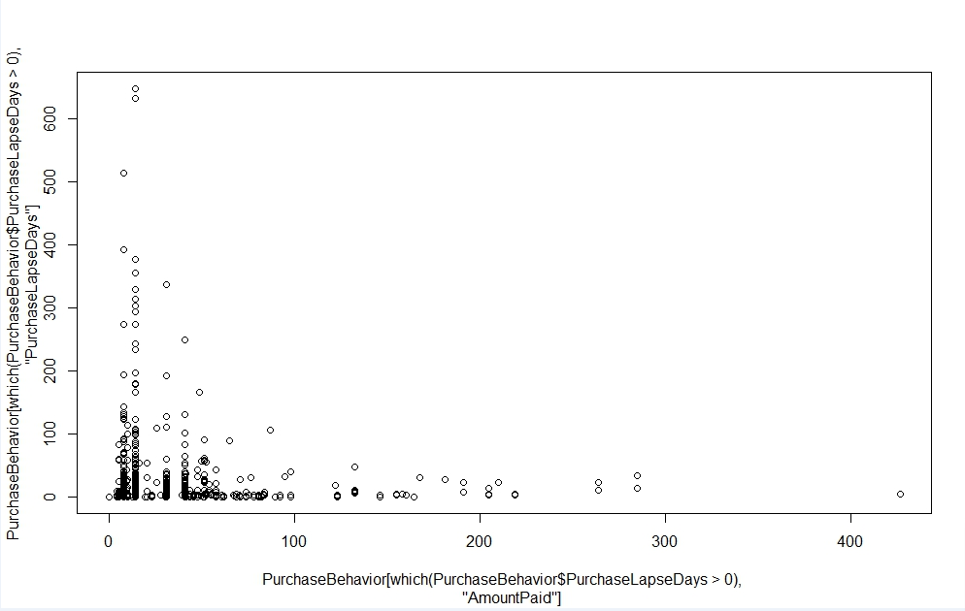
Data Analysis
Purchase lapse date vs all date behavior
Purchase lapse days vs amount paid

Slide 11
Data Cleaning and Preparation for modeling
1. Treat Outliers & Missing Values
5. Drop Unwanted columns
2.Feature Engineering
4. Convert Categorical Variables to binary dummies
3. Create Definition for dependent variable

Slide 12
Model
Important Variables created in Feature Engineering Step
Period of Days Covered(PDC)
PDC* is a commonly used measure to define patient adherence, defined as the number of days of medication covered over a time period
e.g If a patient buys 30 pills with a dosage of 1 pill per day and makes do with it for 60 days, his PDC is 30/60=50%
Usually for a patient to be adherent, his PDC should be >80%, but owing to lesser data, a relaxed constraint of PDC viz 70% is applied for a patient to be considered adherent
PDC is measured on days between two transactions at a patient-medicine level and quantity bought
Overlap
Being adherent to a medicine could depend on other medicines patient is consuming, hence number of medicines bought within a dosage period of one medicine is considered as “Overlap”
Missed Dosage till date
The need to purchase a medicine would increase as the missed dosage number increases for that medicine, hence its considered for model
Dependent Variable(PDC% lead)
If PDC>70% in the next transaction at a patient-medicine level, then the D.V is 1 else its 0
*Source: http://www.cognizant.com/InsightsWhitepapers/Predicting-Patient-Adherence-Why-and-How.pdf

Slide 13
Model output results
Recall
Accuracy
 | Actual
Predicted | 0 | 1
0 | 190 | 32
1 | 11 | 1062
Training
98.97%
96.67%
 | Actual
Predicted | 0 | 1
0 | 125 | 27
1 | 6 | 705
Testing
99.15%
96.17%

Slide 14
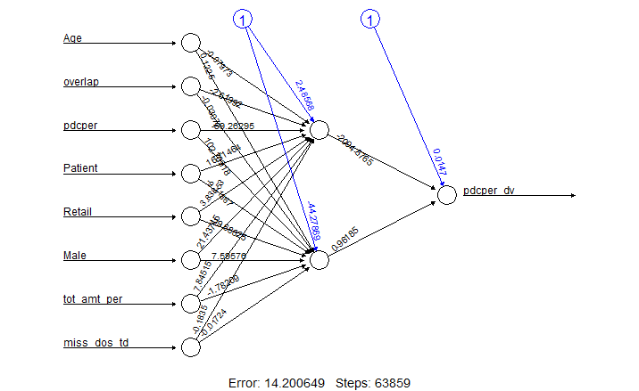
Neural Network Model is able to predict the non adherence at very high accuracy
Age of the Patient
No of other drugs consumed in same period
PDC% @Patient Medicine Level till date
Is the drug bought by the Patient?
Is the drug bought at Retail mode
Is the Patient Male?
% of total Amount spent on this drug for the given transaction
Missed Dosage till date

Slide 15
Output Dataset Snapshot
PatientID | Medication | Age | Sex | Date | Pharmacy | Purchased By | RETAIL/MAIL | For_How_Many_Days | QTY | AmountPaid | Overlap | Total Amount paid
1001 | Med1 | 57 | M | 2/9/2011 | PHARMACY 1523 | Patient Only | R | 30 | 30 | 14.35 | 6 | 61.5
1001 | Med12 | 57 | M | 2/9/2011 | PHARMACY 1523 | Patient Only | R | 30 | 30 | 8.2 | 6 | 61.5
1001 | Med16 | 57 | M | 2/9/2011 | PHARMACY 1523 | Patient Only | R | 30 | 30 | 30.75 | 6 | 61.5
1001 | Med3 | 57 | M | 2/9/2011 | PHARMACY 1523 | Patient Only | R | 30 | 30 | 8.2 | 6 | 61.5
1001 | Med6 | 57 | M | ######## | PHARMACY 1523 | Patient Only | R | 30 | 30 | 30.75 | 2 | 30.75
1001 | Med13 | 57 | M | ######## | PHARMACY 1523 | Patient Only | R | 30 | 90 | 41 | 2 | 55.35
1001 | Med5 | 57 | M | ######## | PHARMACY 1523 | Patient Only | R | 30 | 90 | 14.35 | 2 | 55.35
1001 | Med13 | 57 | M | ######## | PHARMACY 1523 | Patient Only | R | 30 | 90 | 41 | 7 | 55.35

Slide 16

End to End Patient Adherence System

